Slide 1
بحث روزهای دوشنبه بخش غدد براساس شرح حال بیمار برای دستیاران تخصصی داخلی

Slide 16
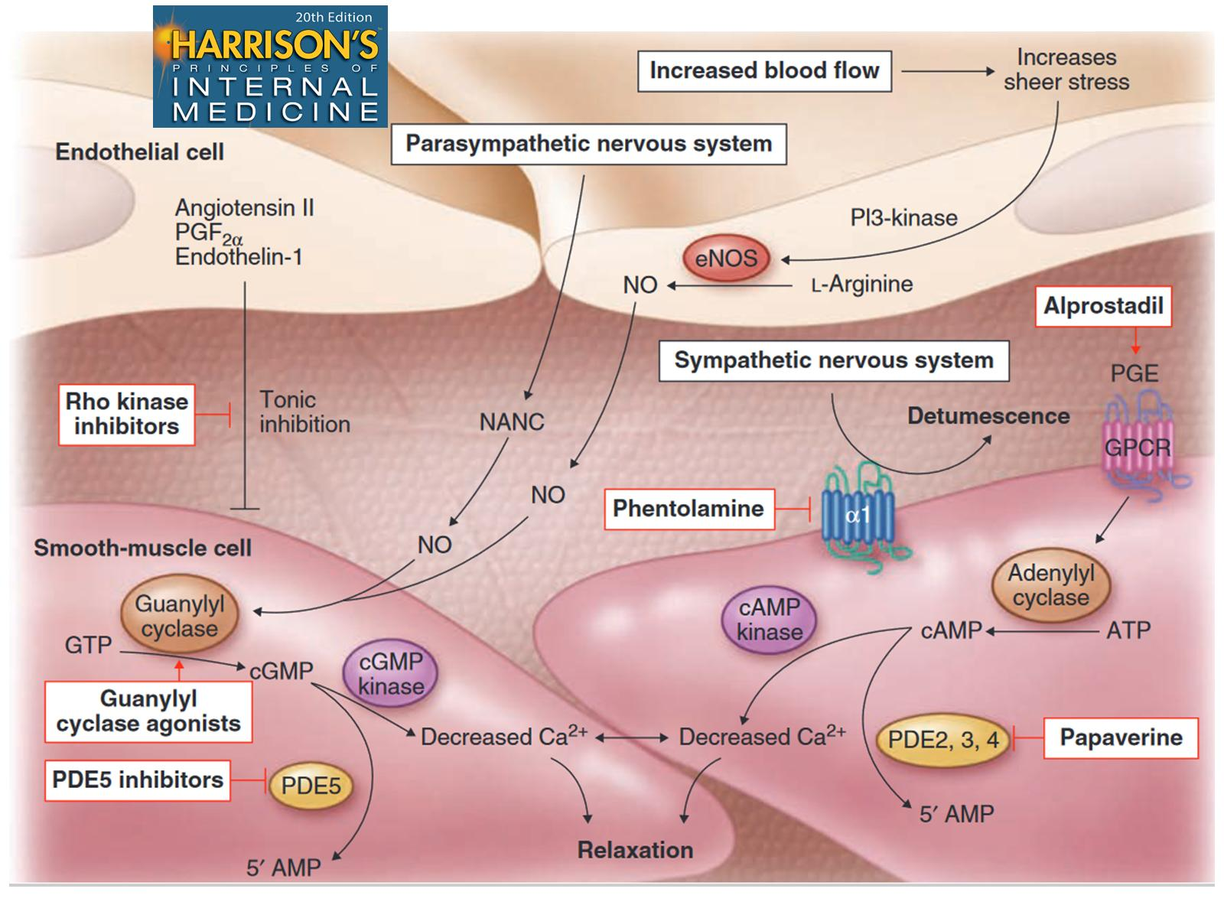

Slide 19
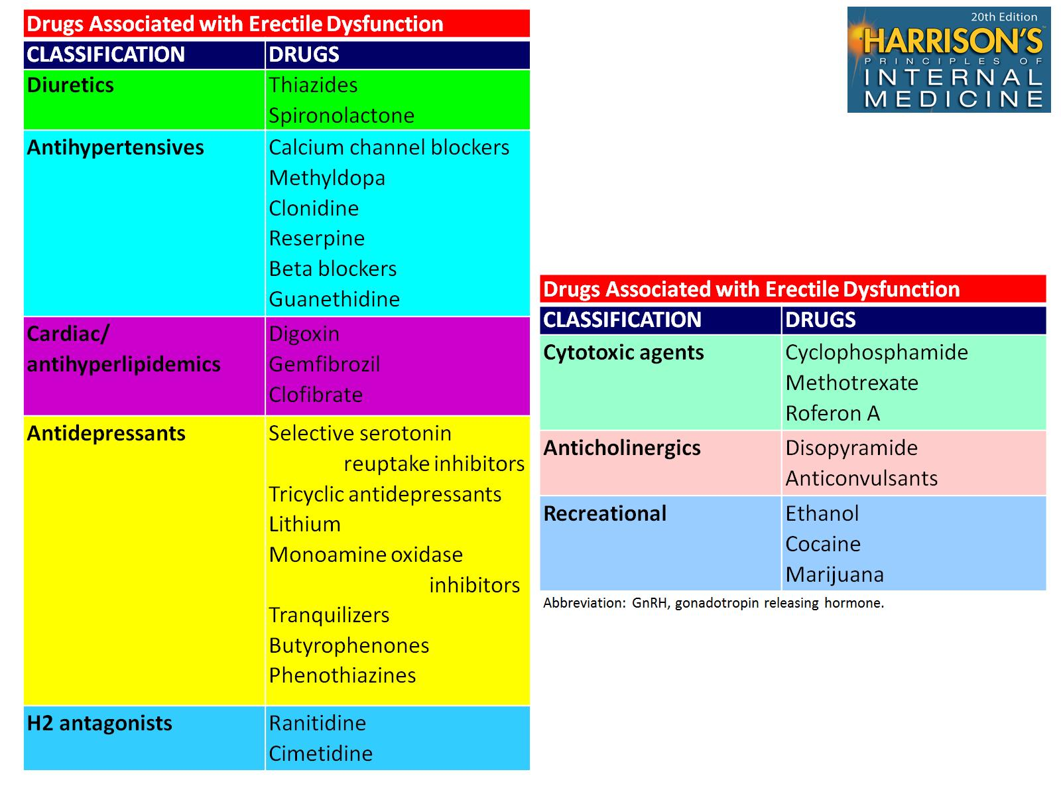

Slide 21
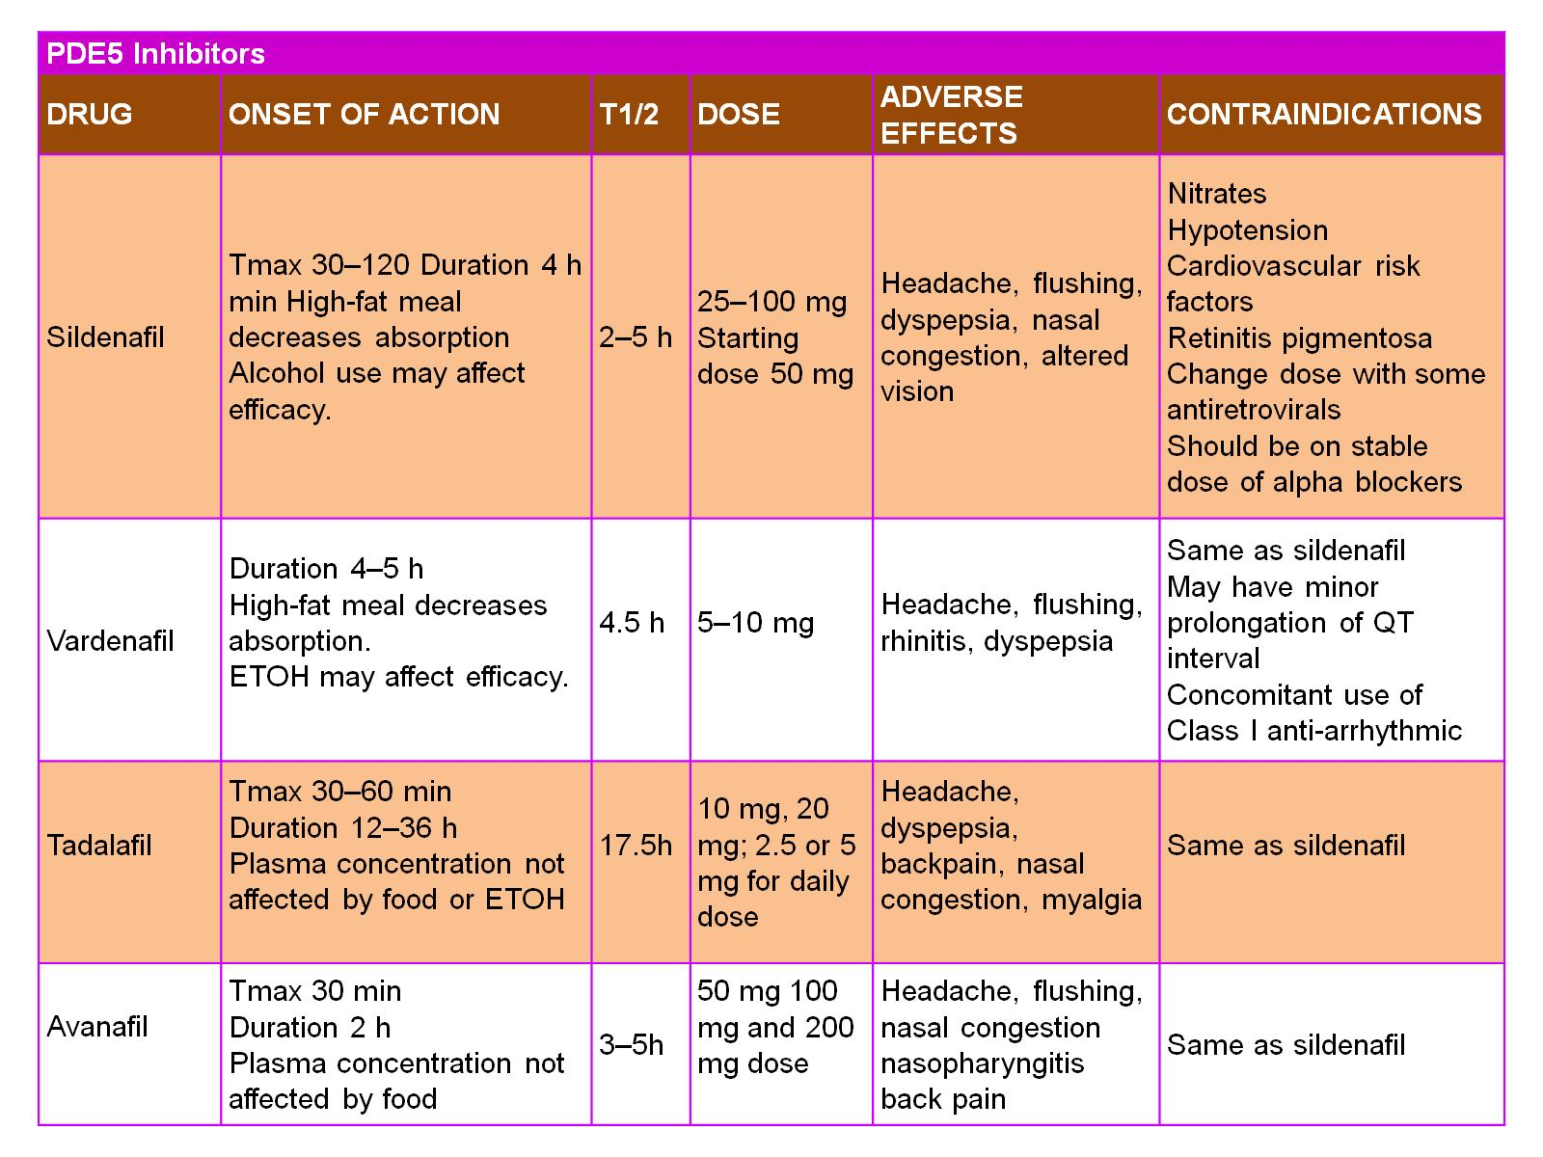

Slide 23
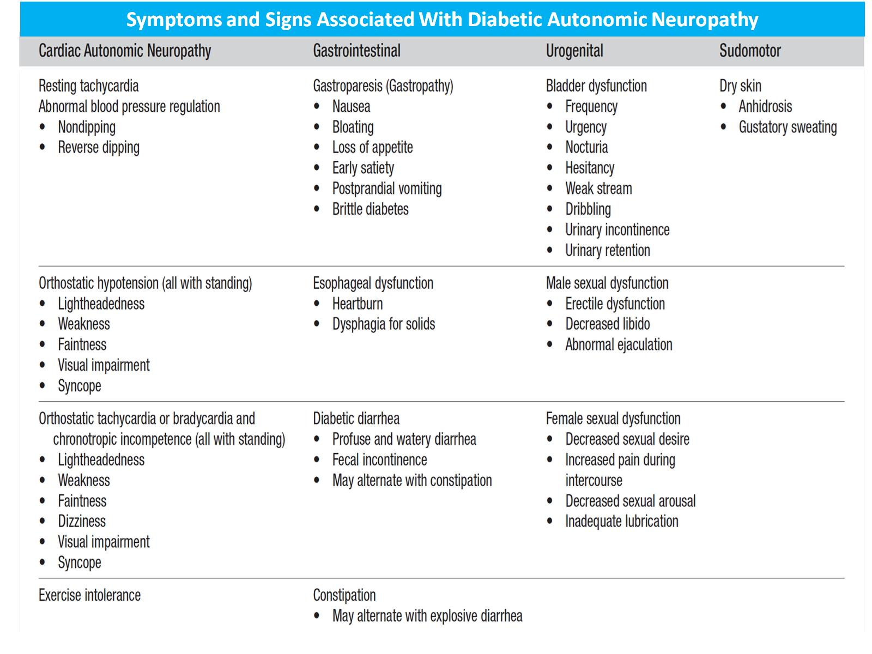

Slide 24
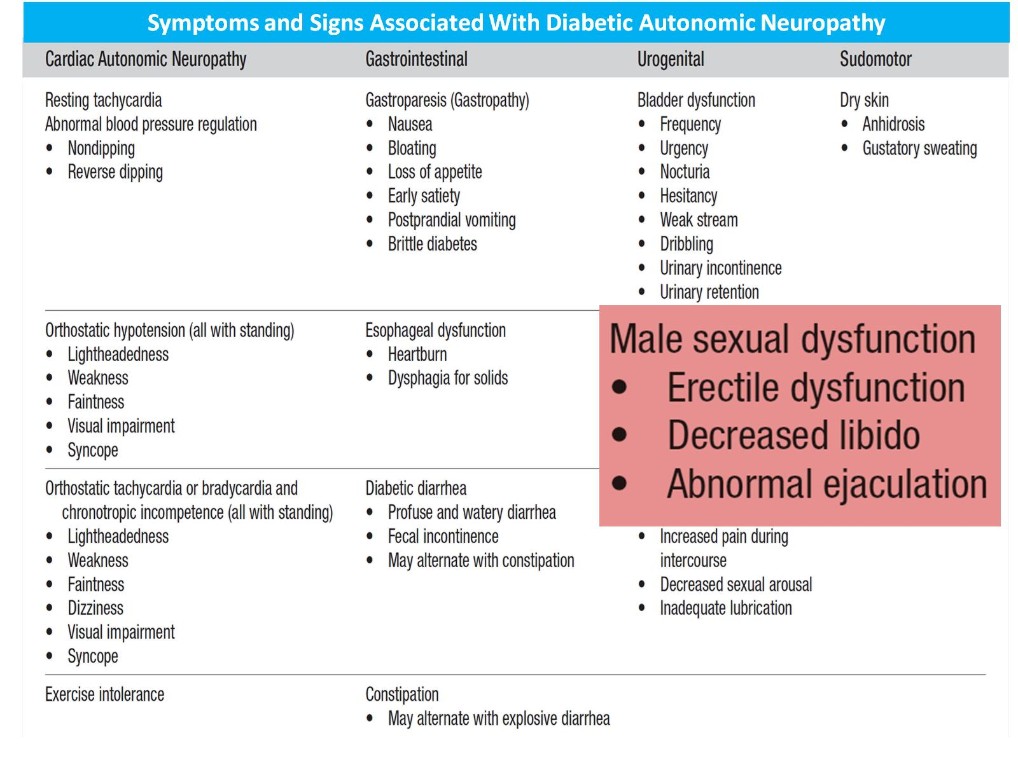

Slide 25
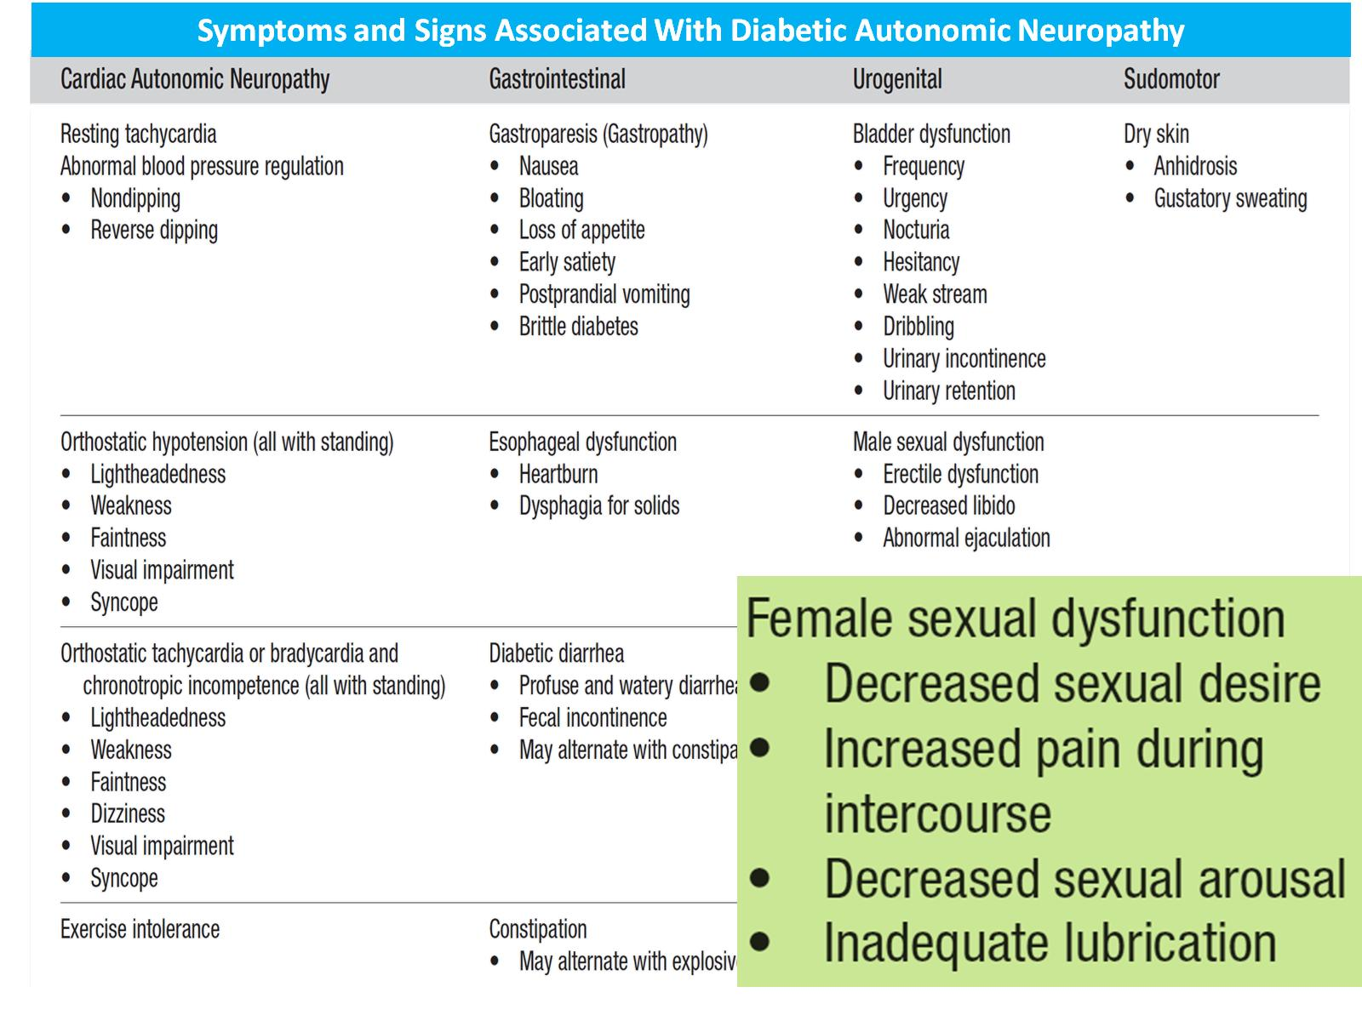

Slide 27
Screen for ED

Slide 35
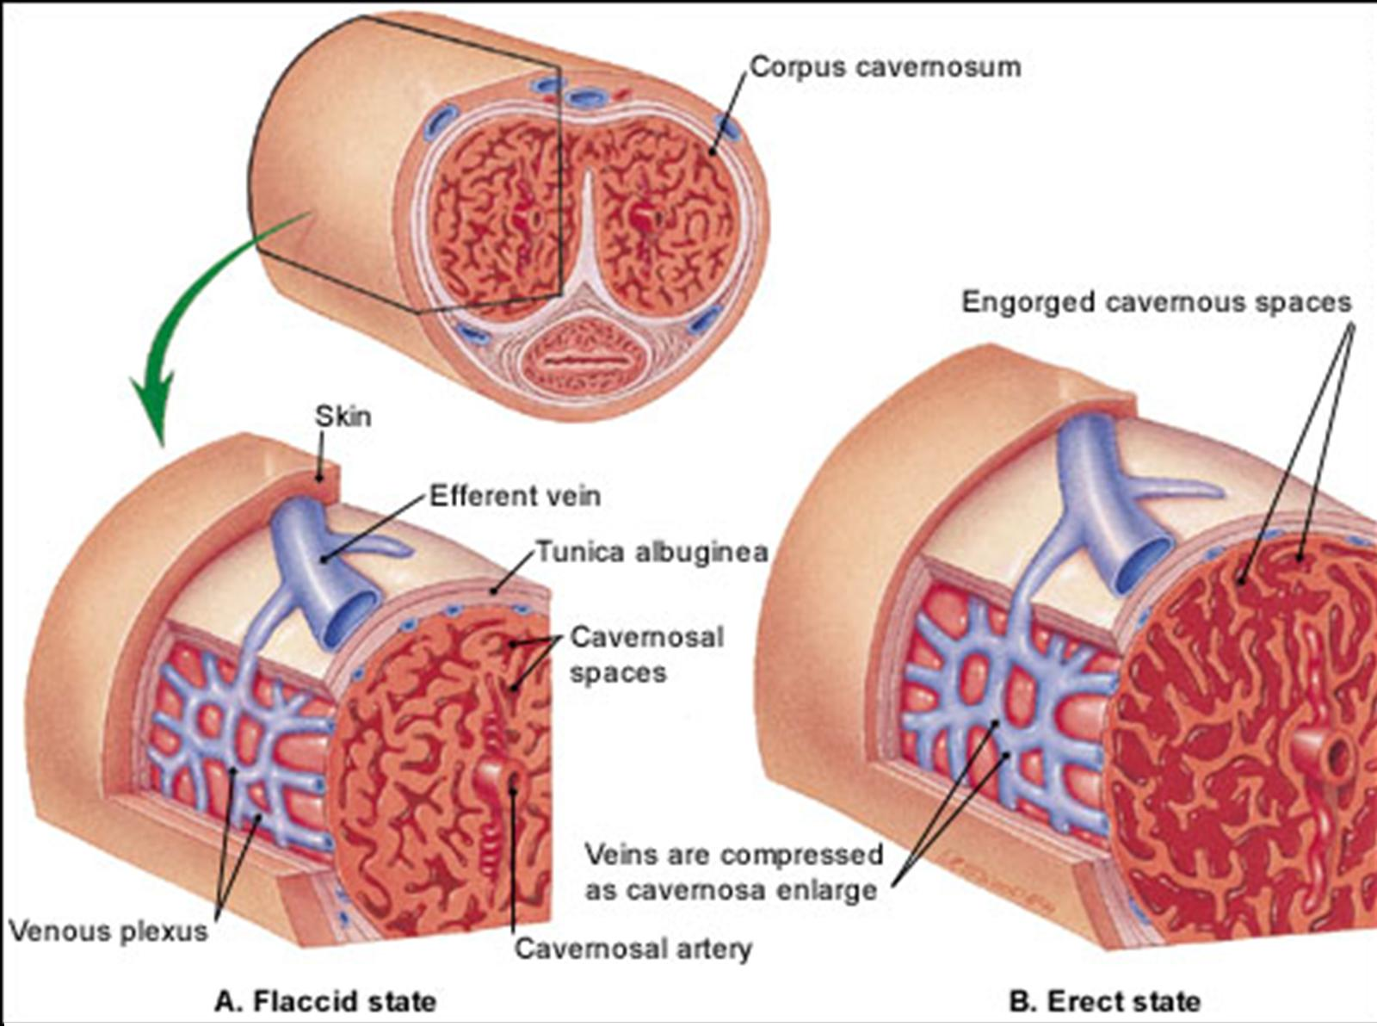

Slide 36
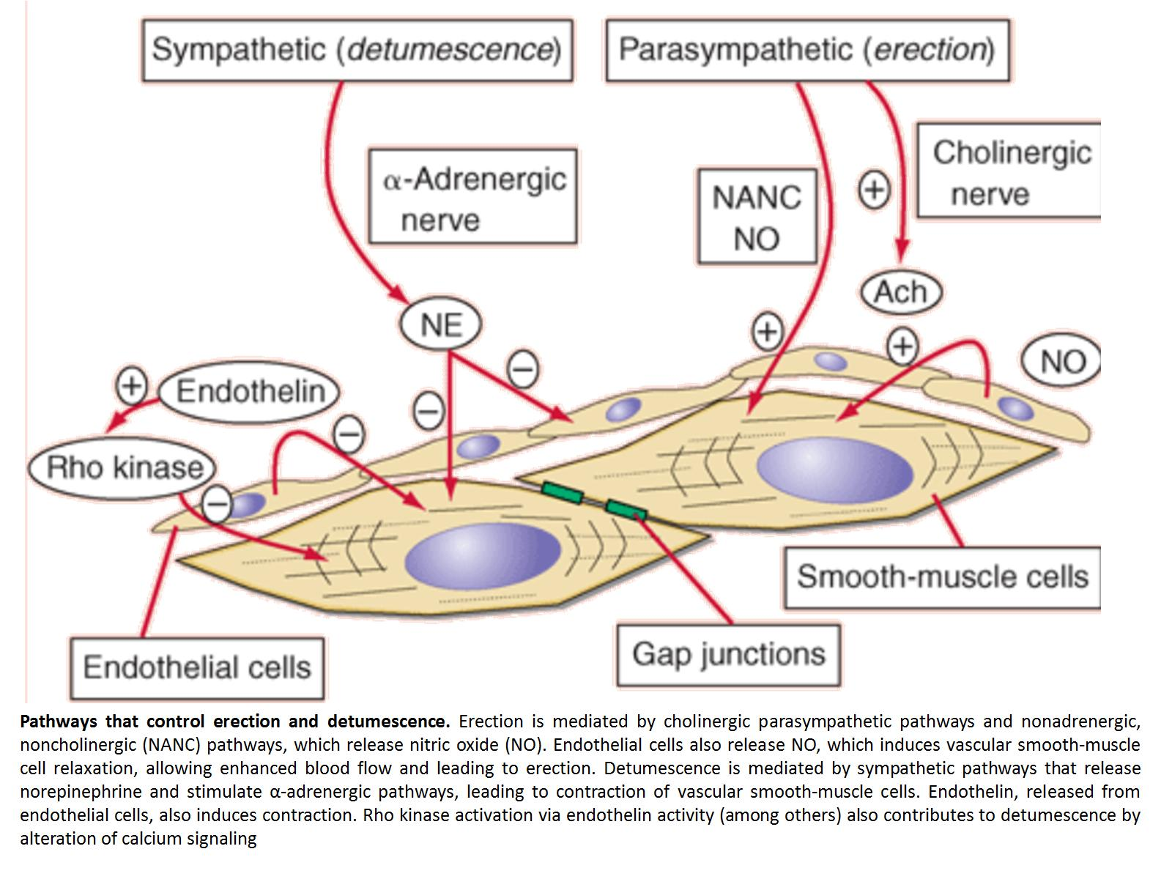

Slide 41
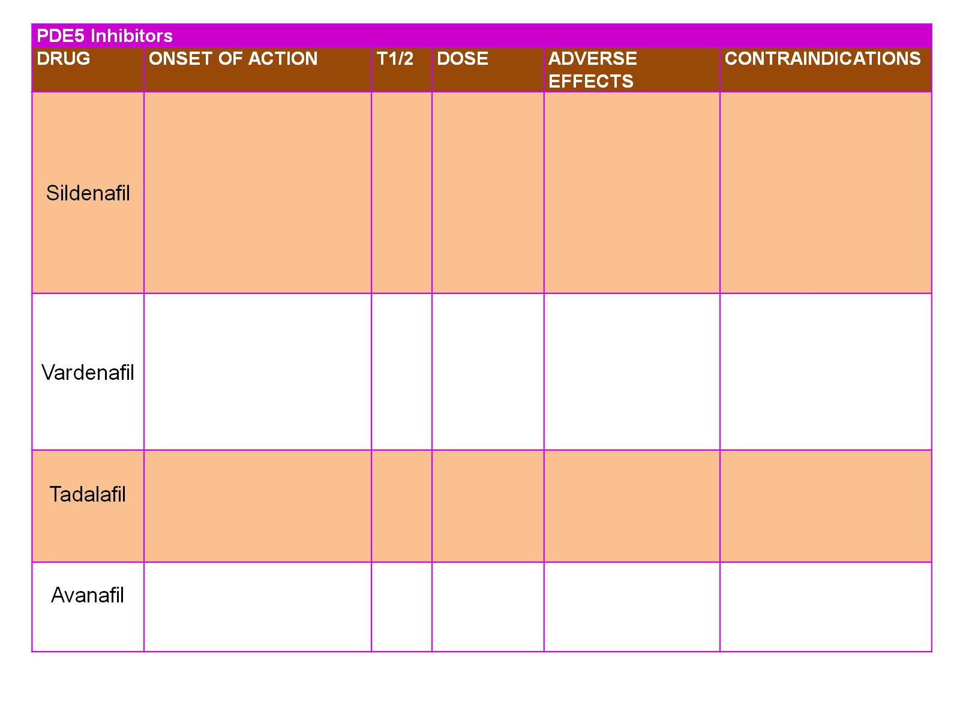

Slide 46
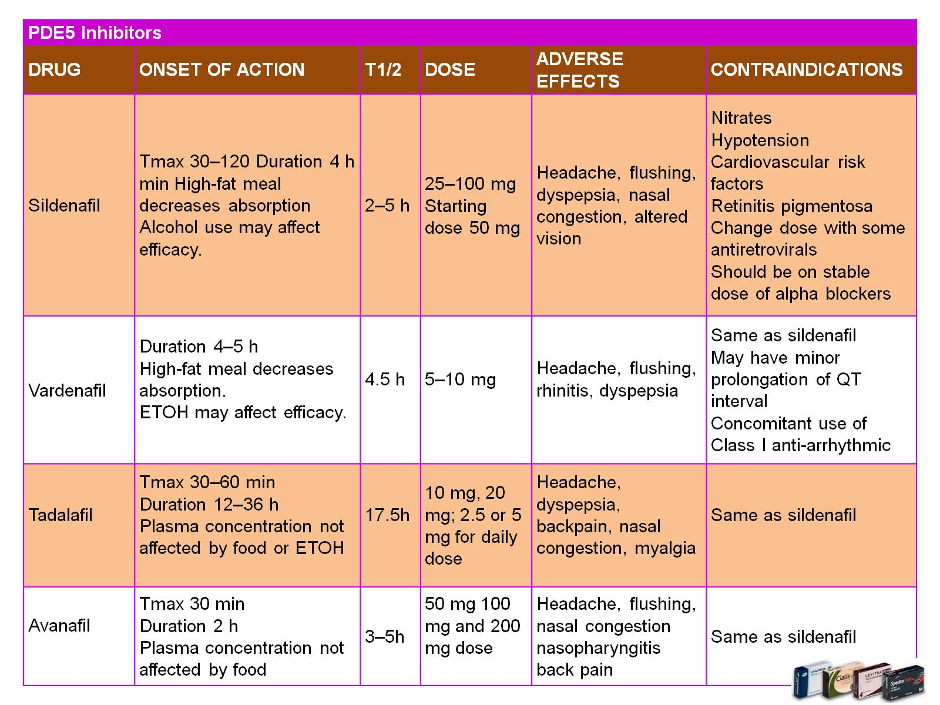

Slide 47
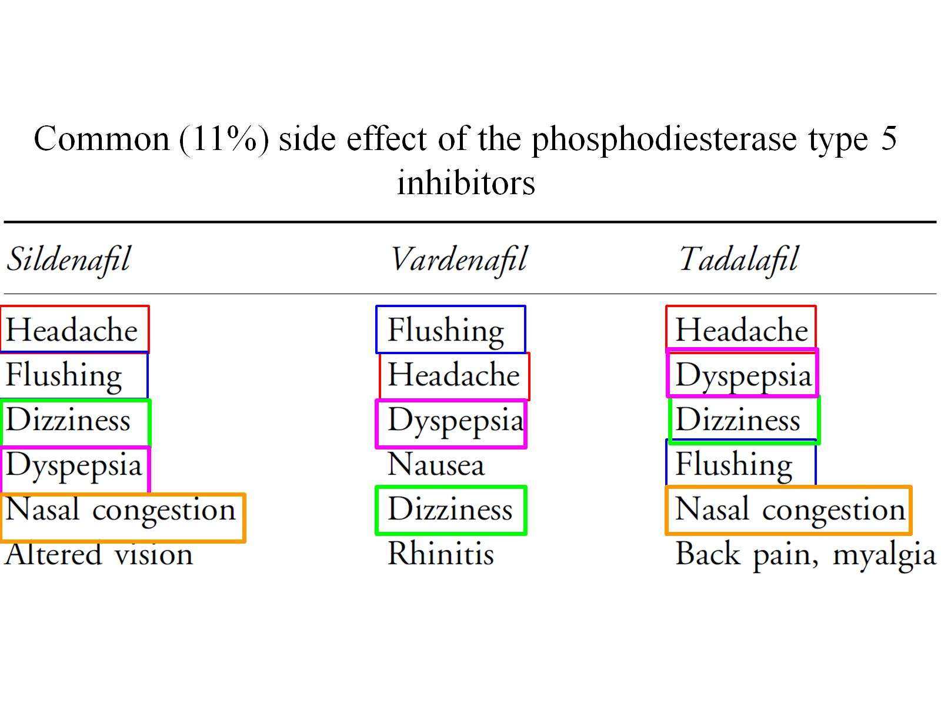

Slide 49
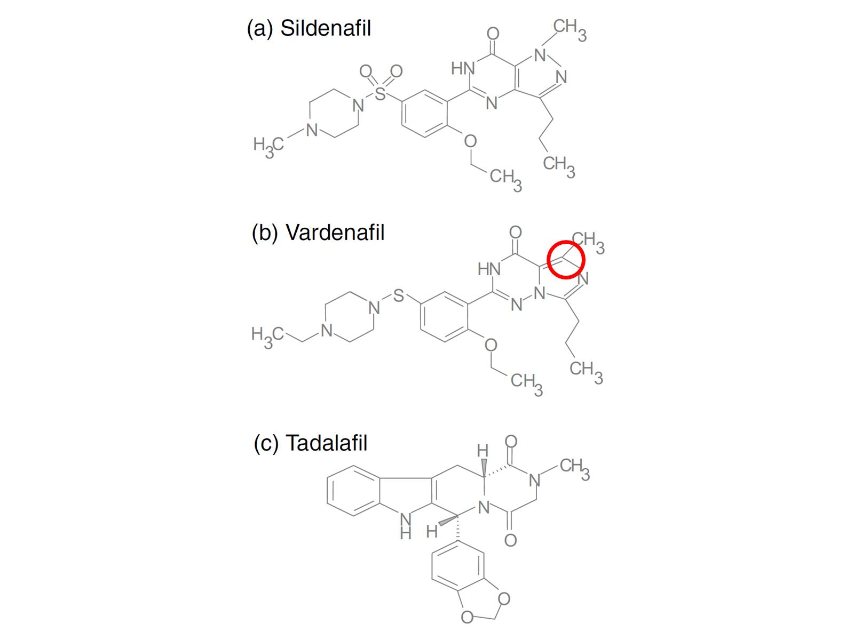

Slide 64
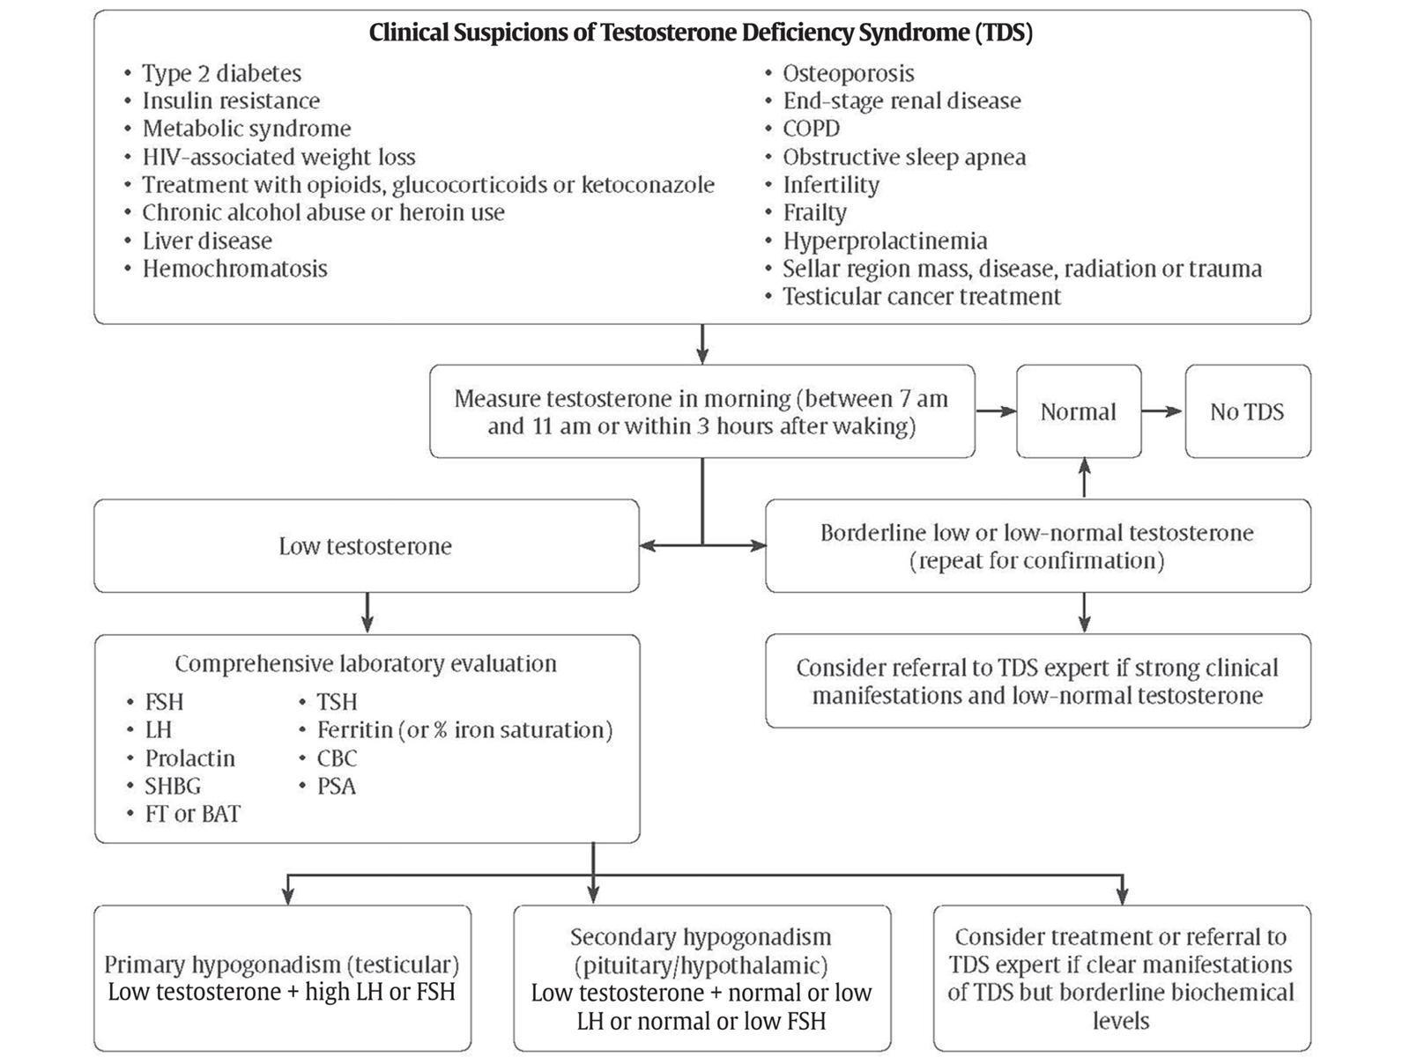

Slide 65
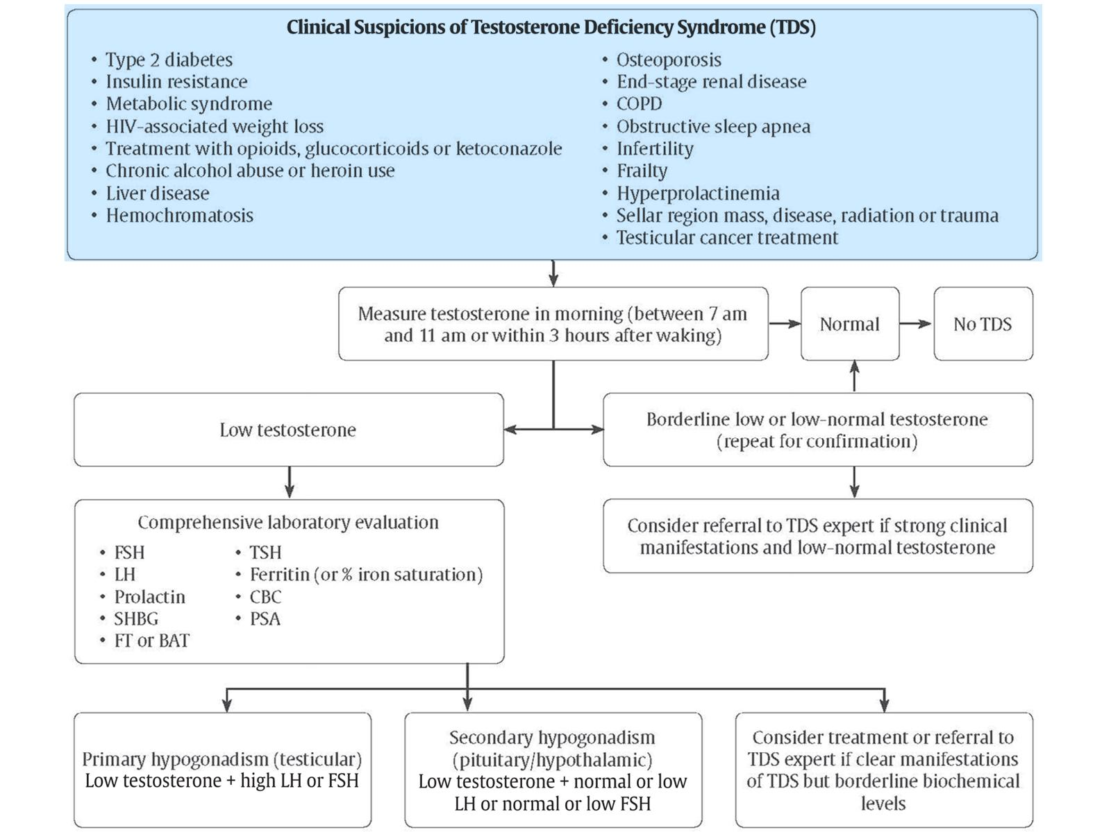

Slide 66
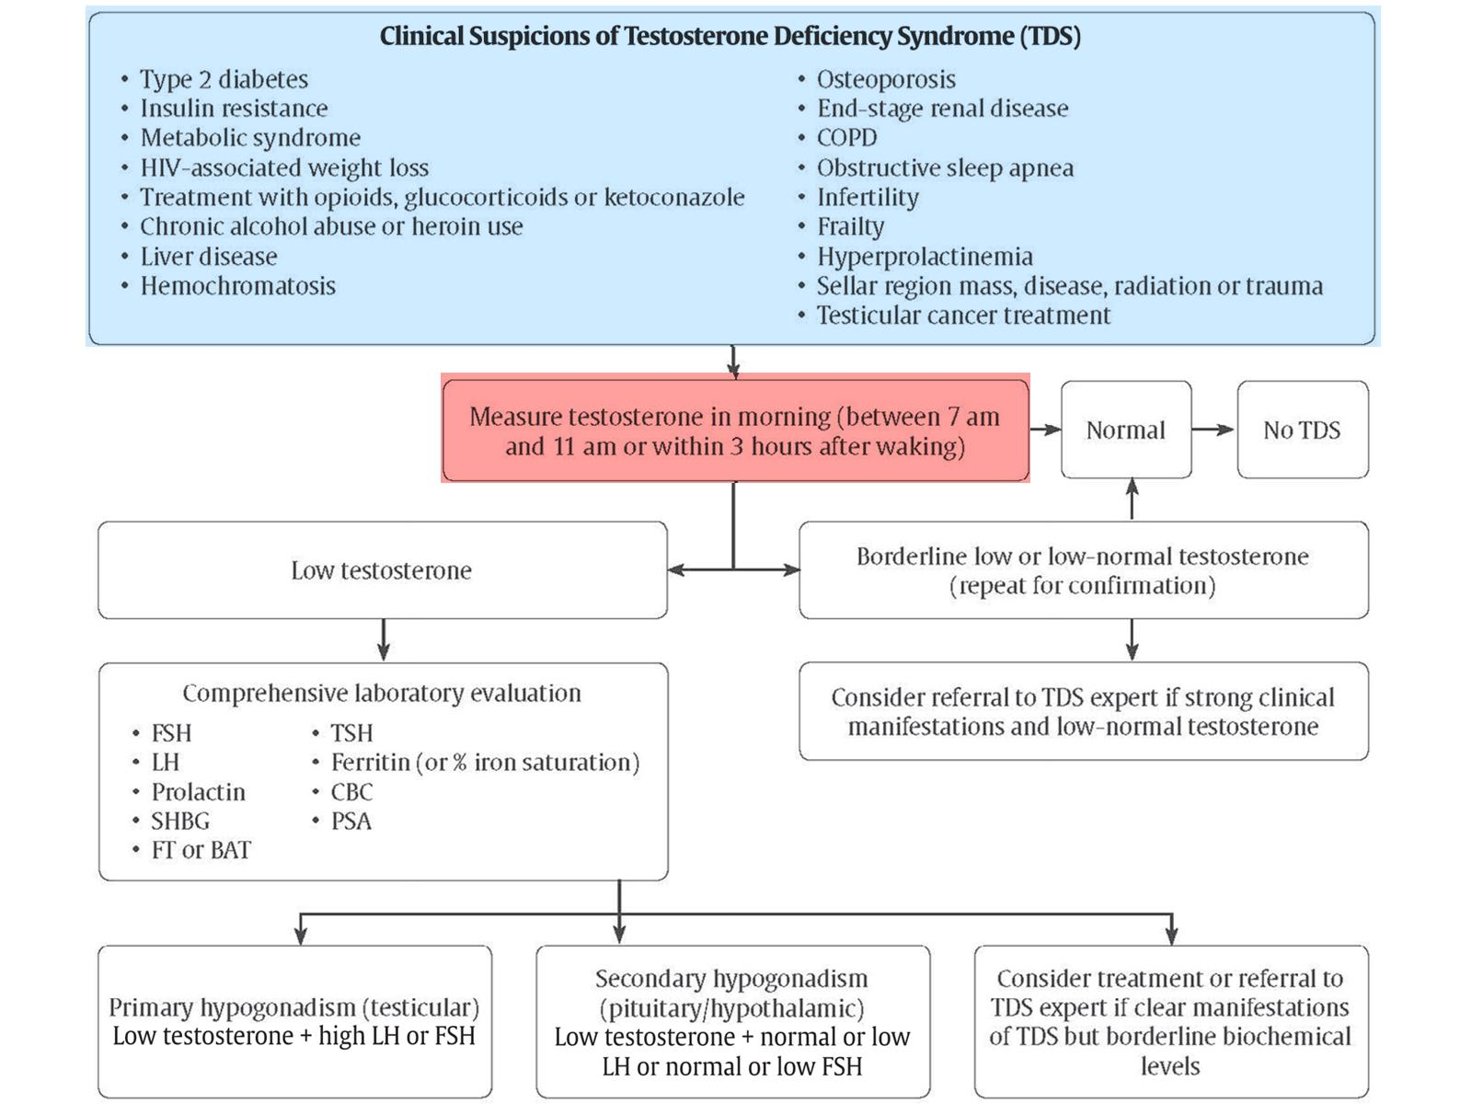

Slide 67
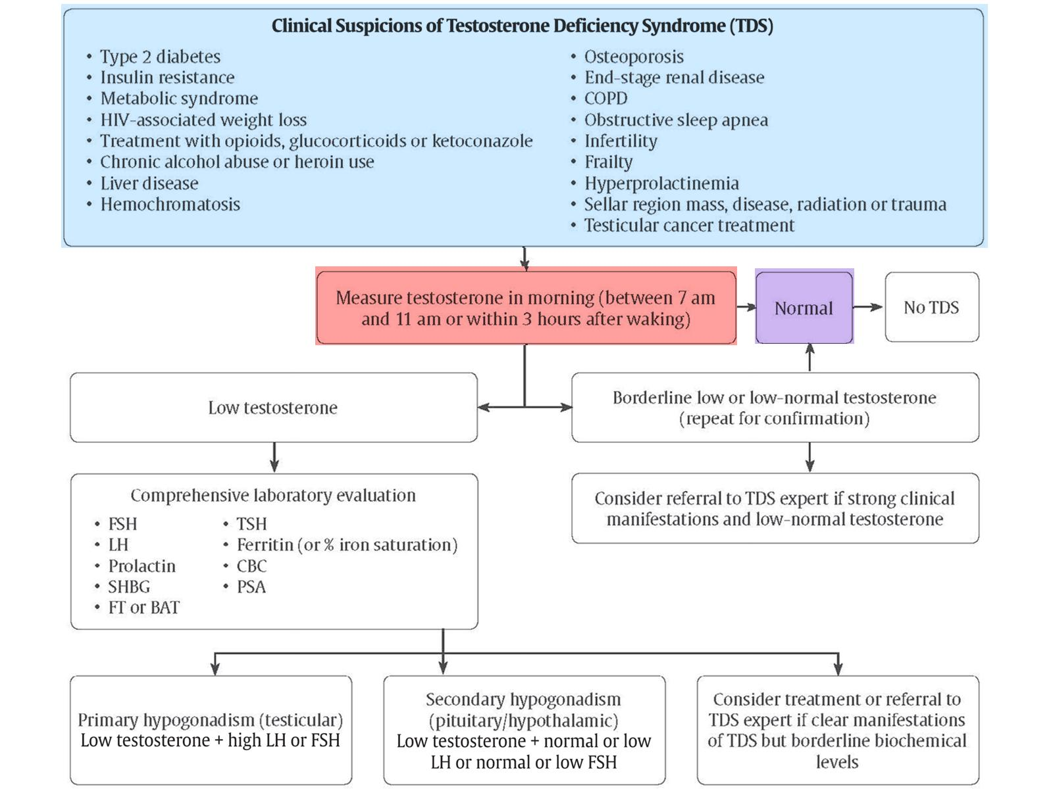

Slide 68
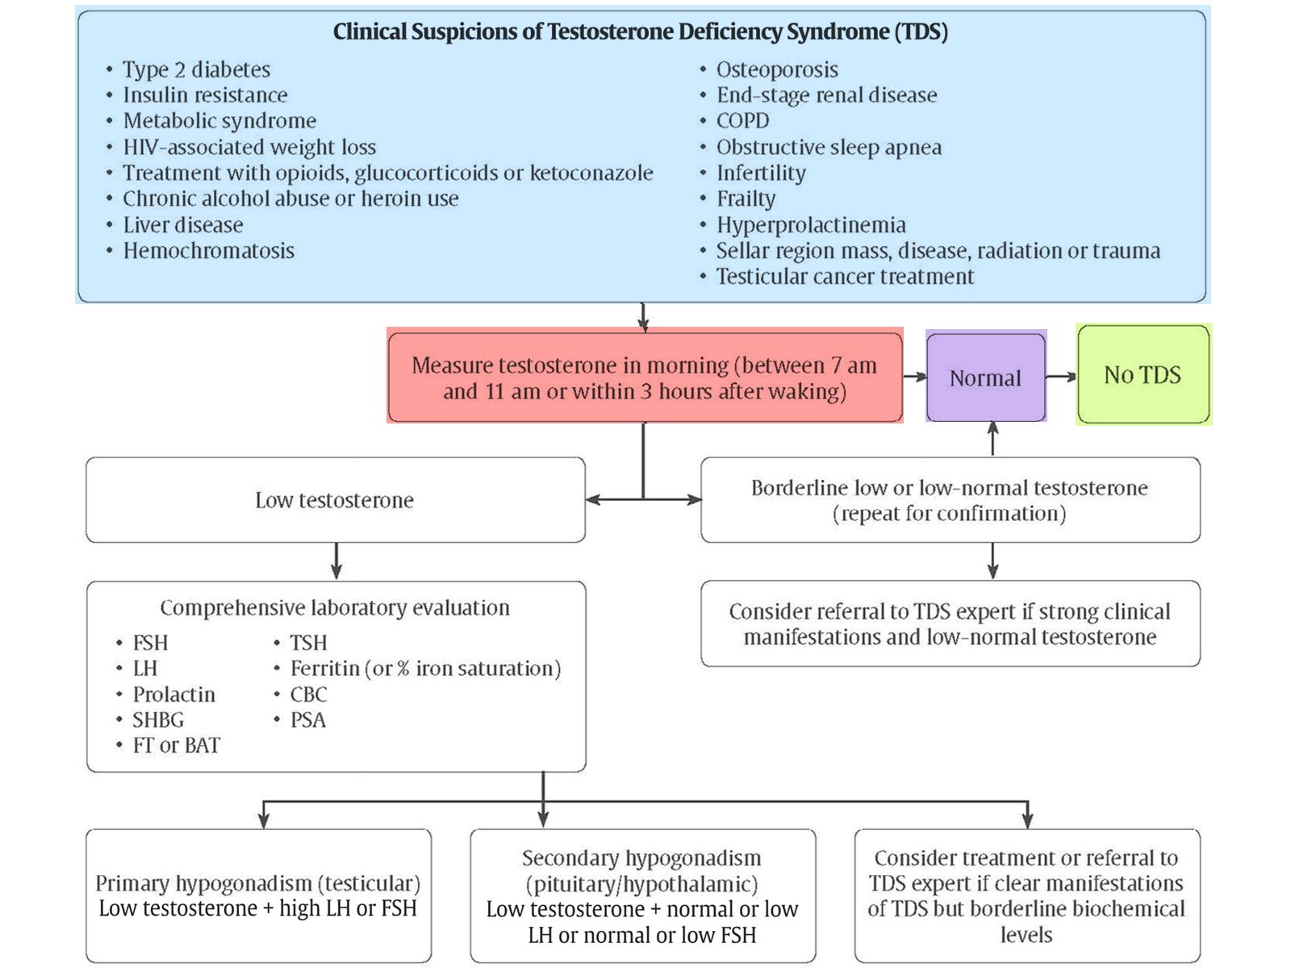

Slide 69
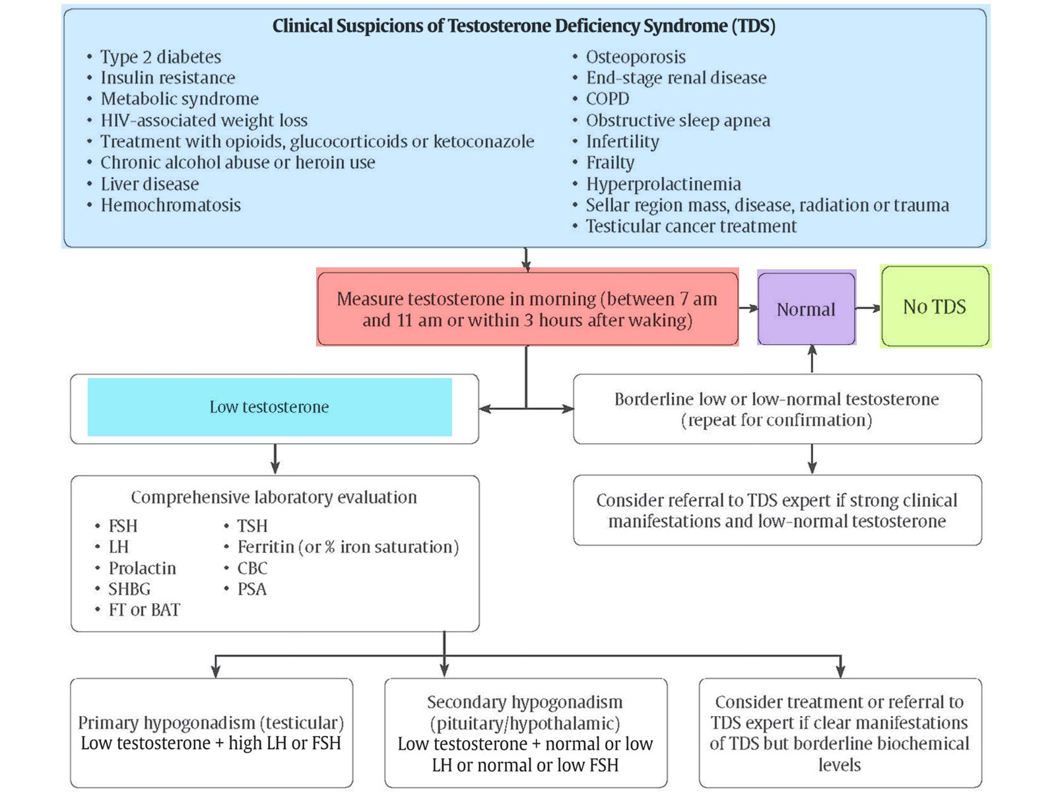

Slide 70
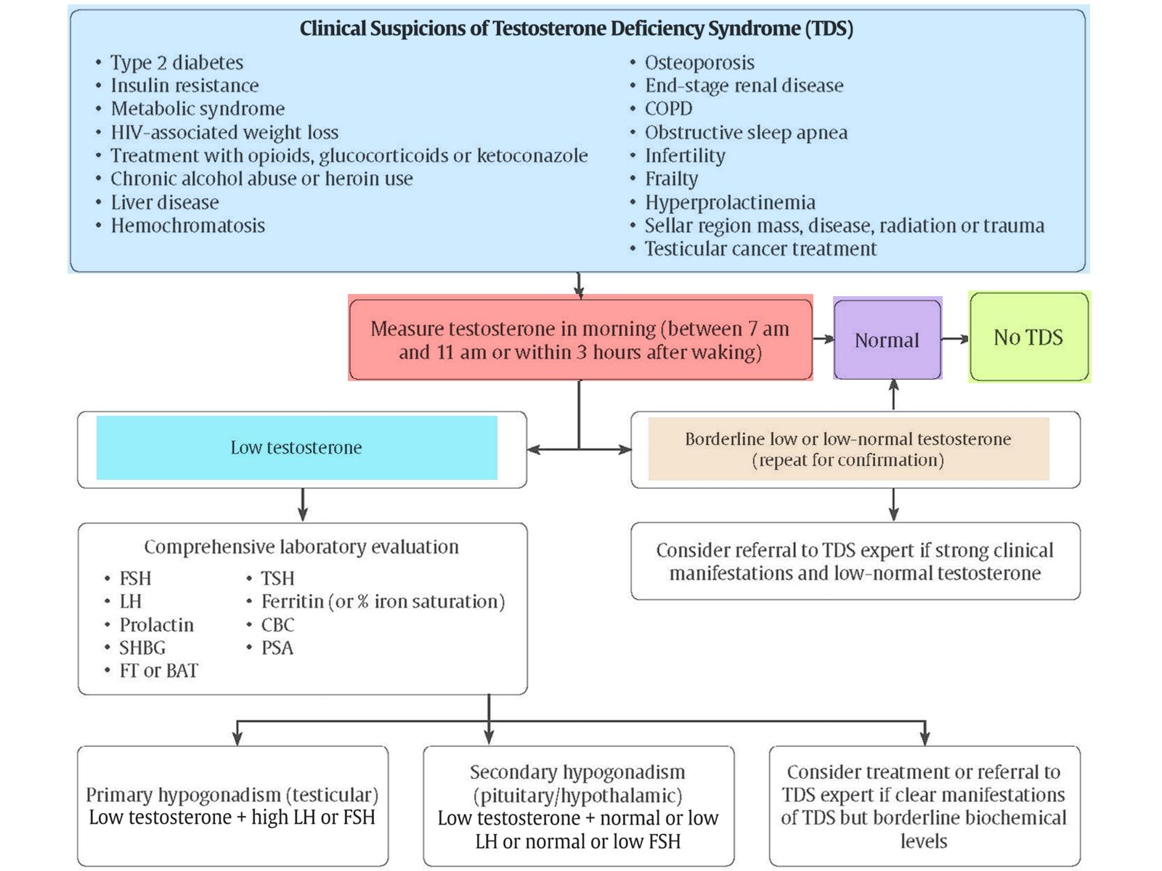

Slide 71
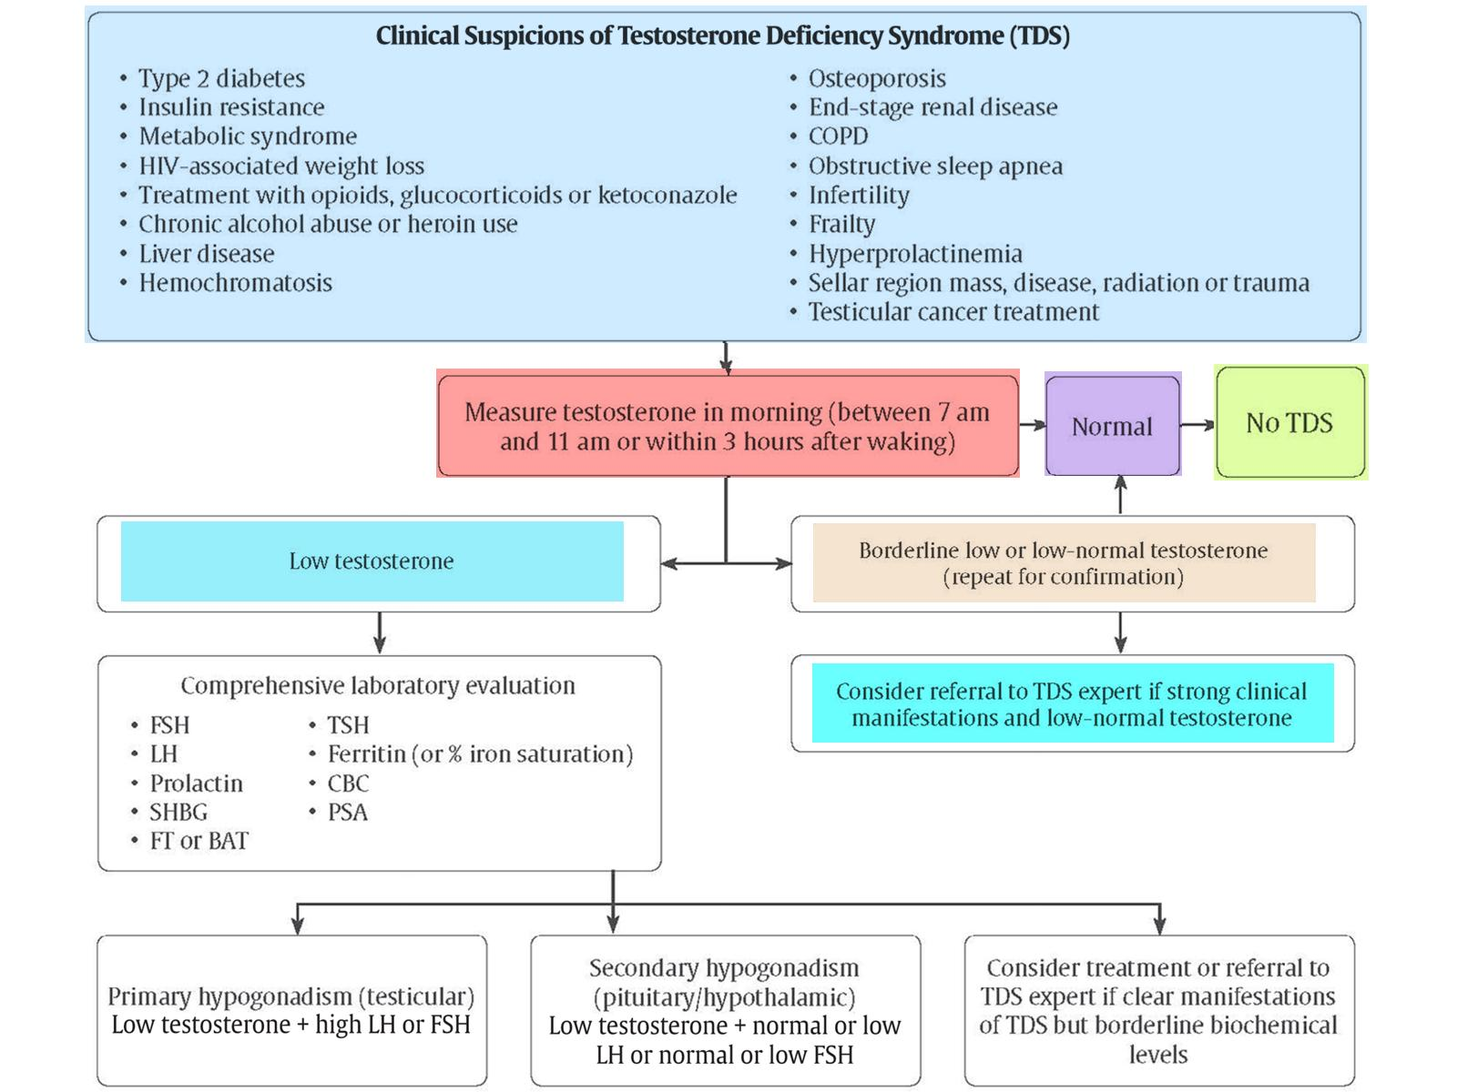

Slide 72
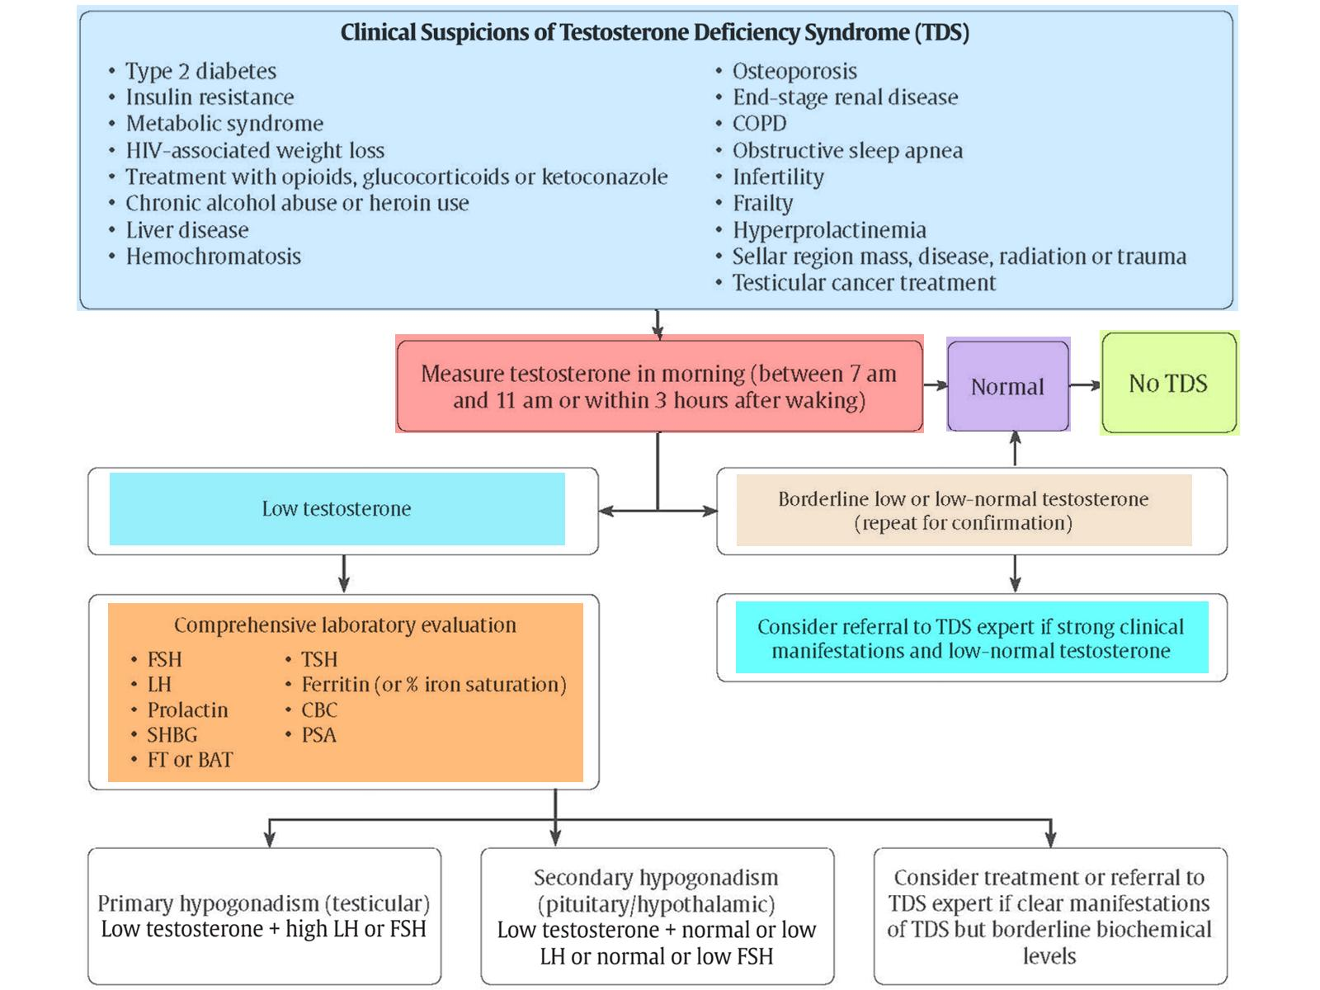

Slide 74
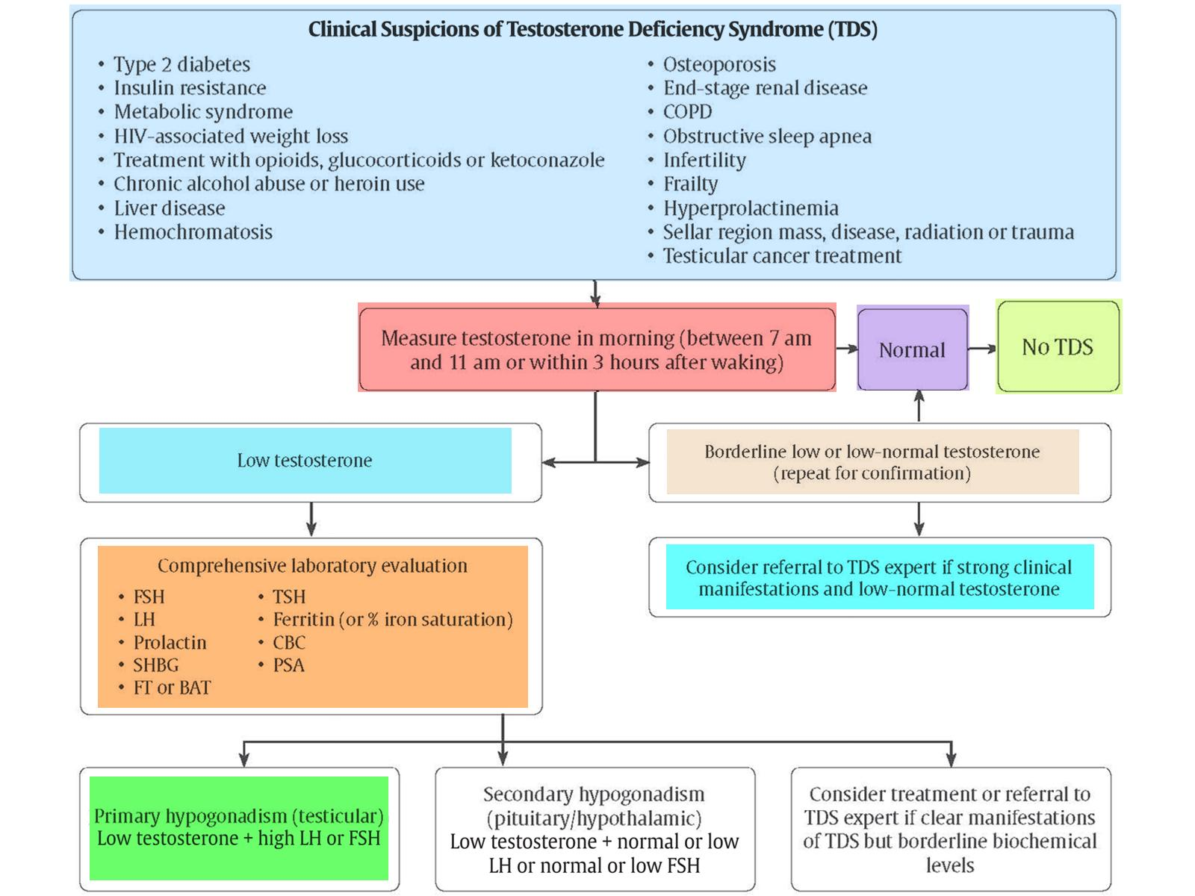

Slide 75
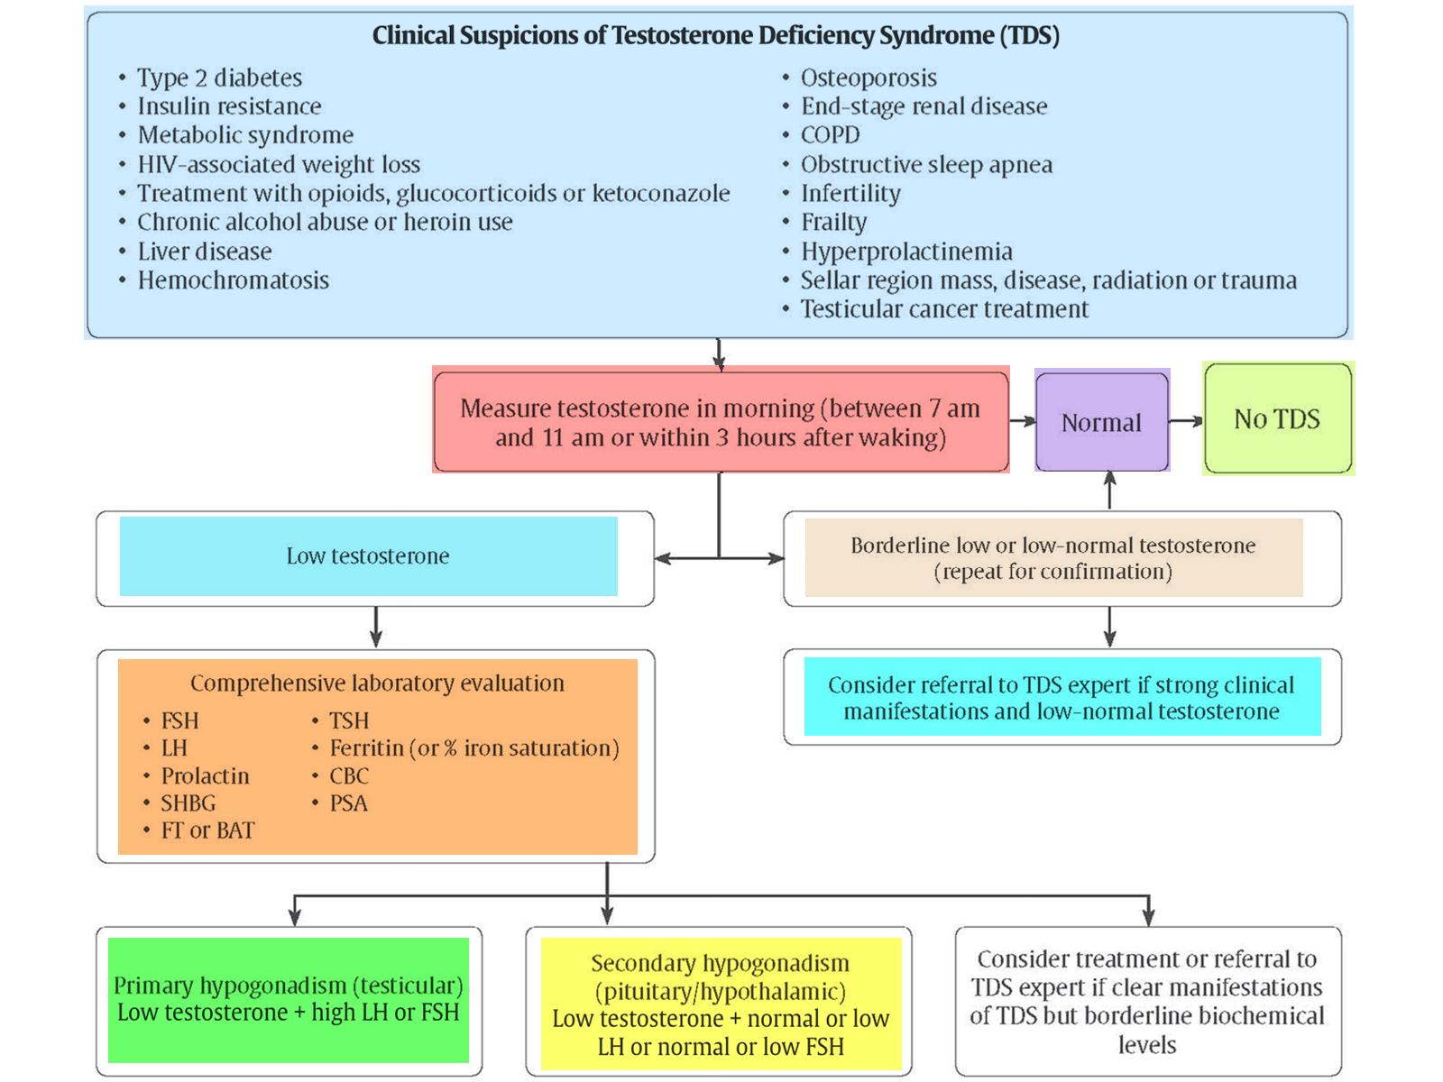

Slide 76
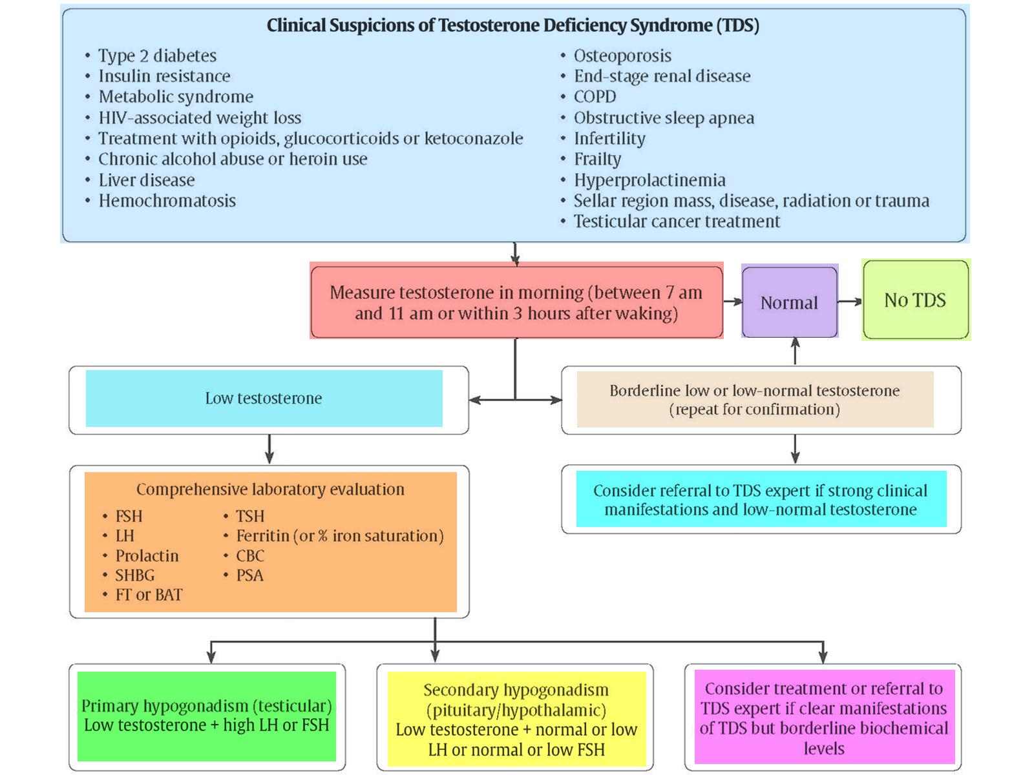

Slide 77
Recommendations 1-2

Slide 78
Recommendation 3

Slide 79
Recommendations 4-5

Slide 80
Key Messages Regarding Sexual Dysfunction in Men with Diabetes

Slide 81
Key Messages Regarding Sexual Dysfunction in Men with Diabetes

Slide 82
Key Messages Regarding Hypogonadism in Men with Diabetes

Slide 83
Erectile Dysfunction (ED) Checklist

Slide 84
Key Messages for People with Diabetes

